Slide 1
“Project Title”
Guided/Co-Guided By,
Presented By
Mr. Utkarsh Hajare

Slide 2
Contents
Introduction
Technology Used
Tools Used
Project Flow Diagram
Implementation
Challenges Faced & Overcome
Learnings
Demo
Questions

Slide 3
Introduction
Domain : Application/DS
Introduction : In today's fast-paced world, finding reliable and skilled home service workers can be a daunting task for homeowners. Traditional methods of hiring such workers often involve time-consuming searches, unreliable recommendations, and lack of transparency in pricing and quality of service. Additionally, payment processes may not always be convenient or secure, and there's often limited ability to provide feedback or reviews.
This website is poised to transform the way homeowners connect with skilled workers for their household needs. In today's fast-paced world, finding reliable and trustworthy workers can be a daunting task, often involving time-consuming searches, unreliable recommendations, and lack of transparency. Our app aims to revolutionize this process by providing a comprehensive solution that simplifies the entire experience for both customers and service providers.

Slide 4
Technology Used
Front End: HTML, CSS, TypeScript, Angular.js
Back End: Java, SpringBoot.
Database: MySql

Slide 5
Tools Used
Resource Requirements:
VS Code for Frontend Developing in HTML, CSS, and TypeScript.
Eclipse for Backend Developing in Java and Spring Boot.
Database Administrators with expertise in SQL.

Slide 6
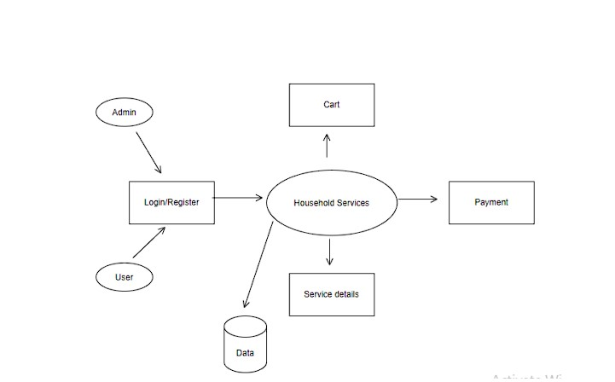
Flow Diagram

Slide 7
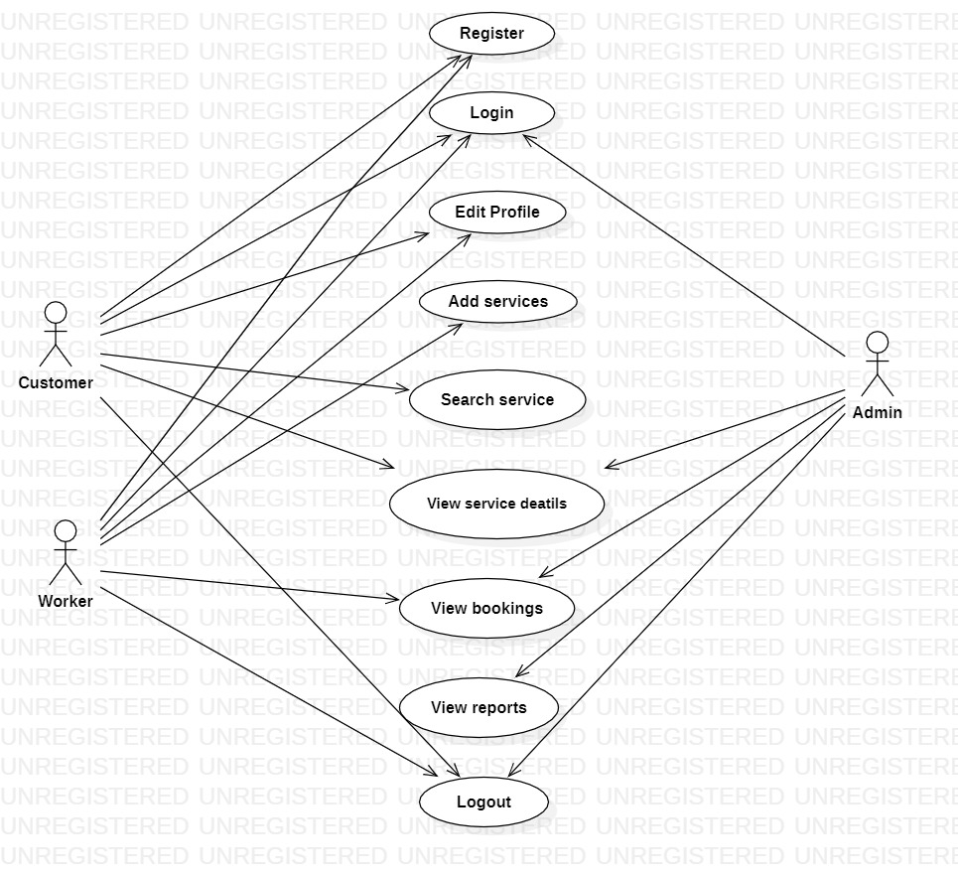
Use Case Diagram:

Slide 8
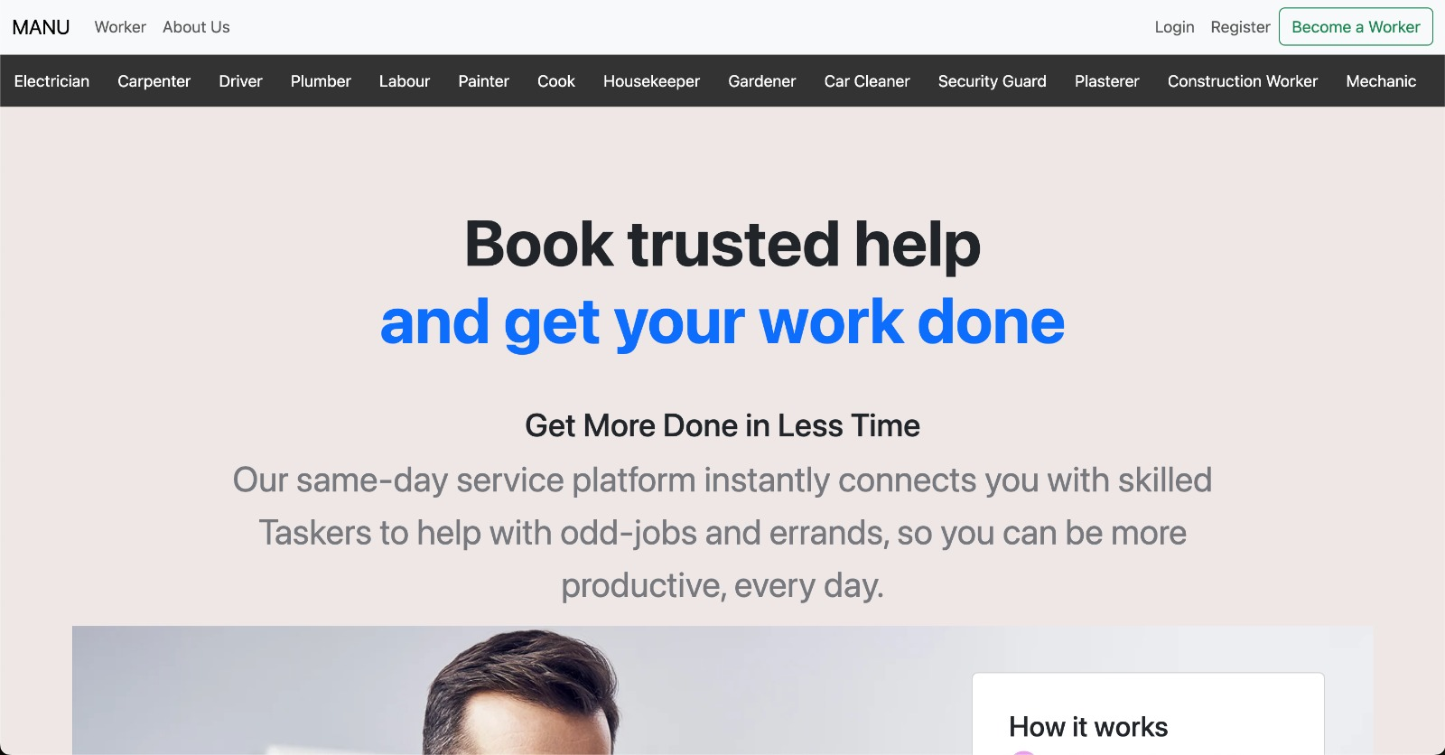
Implementation

Slide 9
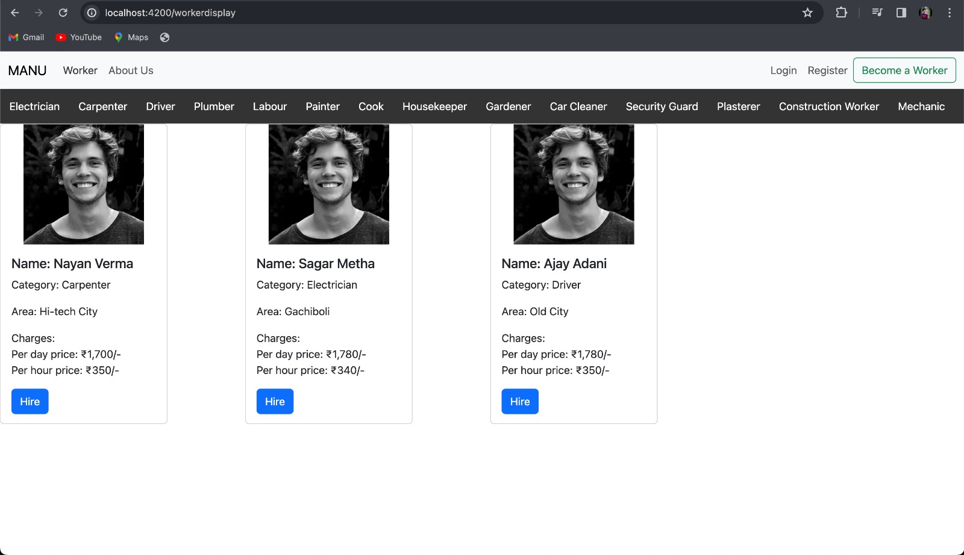
Implementation

Slide 10
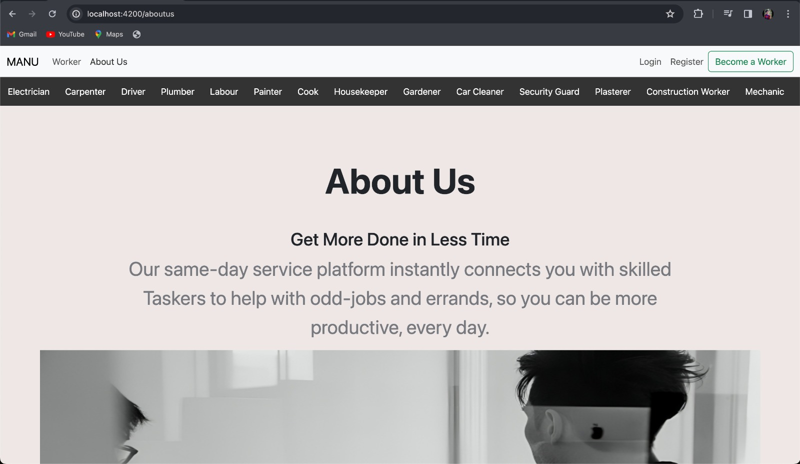
Implementation

Slide 11
Challenges Faced & Overcome
User Interface Design: Designing an intuitive and user-friendly interface that meets the needs of both service providers and customers can be challenging. To overcome this challenge, it's crucial to conduct user research and usability testing to understand user preferences and pain points. Iterative design processes, feedback loops, and prototyping can help refine the user interface and ensure a positive user experience.
Security and Privacy: Protecting user data, transactions, and communications from security threats such as data breaches, hacking, and malicious attacks is critical for maintaining trust and compliance with regulations. To overcome this challenge, it's essential to implement robust security measures, such as encryption, secure authentication, input validation, and regular security audits. Keeping software dependencies up to date and following security best practices can also mitigate security risks.

Slide 12
Learnings
User-Centric Design: Putting the needs and preferences of users at the forefront of the design process is crucial. Understanding user behavior, conducting user research, and incorporating feedback are essential for creating a user-friendly and intuitive website.
Effective Communication: Clear and consistent communication with stakeholders, team members, and clients is essential for project success. Regular updates, feedback sessions, and transparent discussions help ensure alignment and collaboration throughout the development process.
Customer Focus: Placing a strong emphasis on understanding and addressing the needs and pain points of customers fosters loyalty, satisfaction, and long-term success. Prioritizing customer experience and satisfaction drives business growth and sustainability.

Slide 13
Questions
S. B. Jain Institute of Technology Management and Research
13

Slide 14
Thank You

